Slide 1
Final it-mix
project
Roger K. Weber
Yasin I. Aden
Pau Francino
Boris Llona

Slide 2
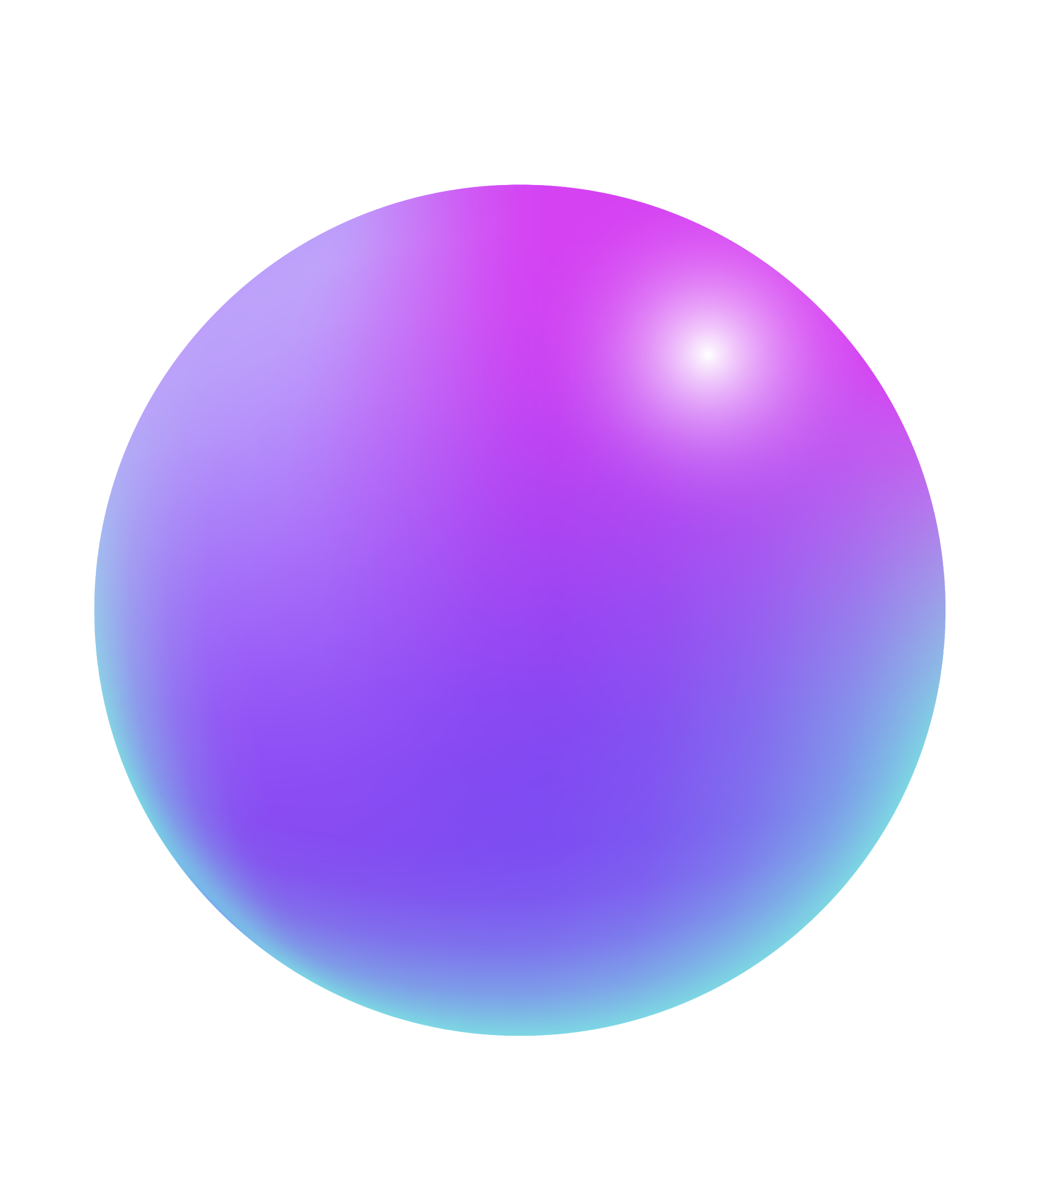
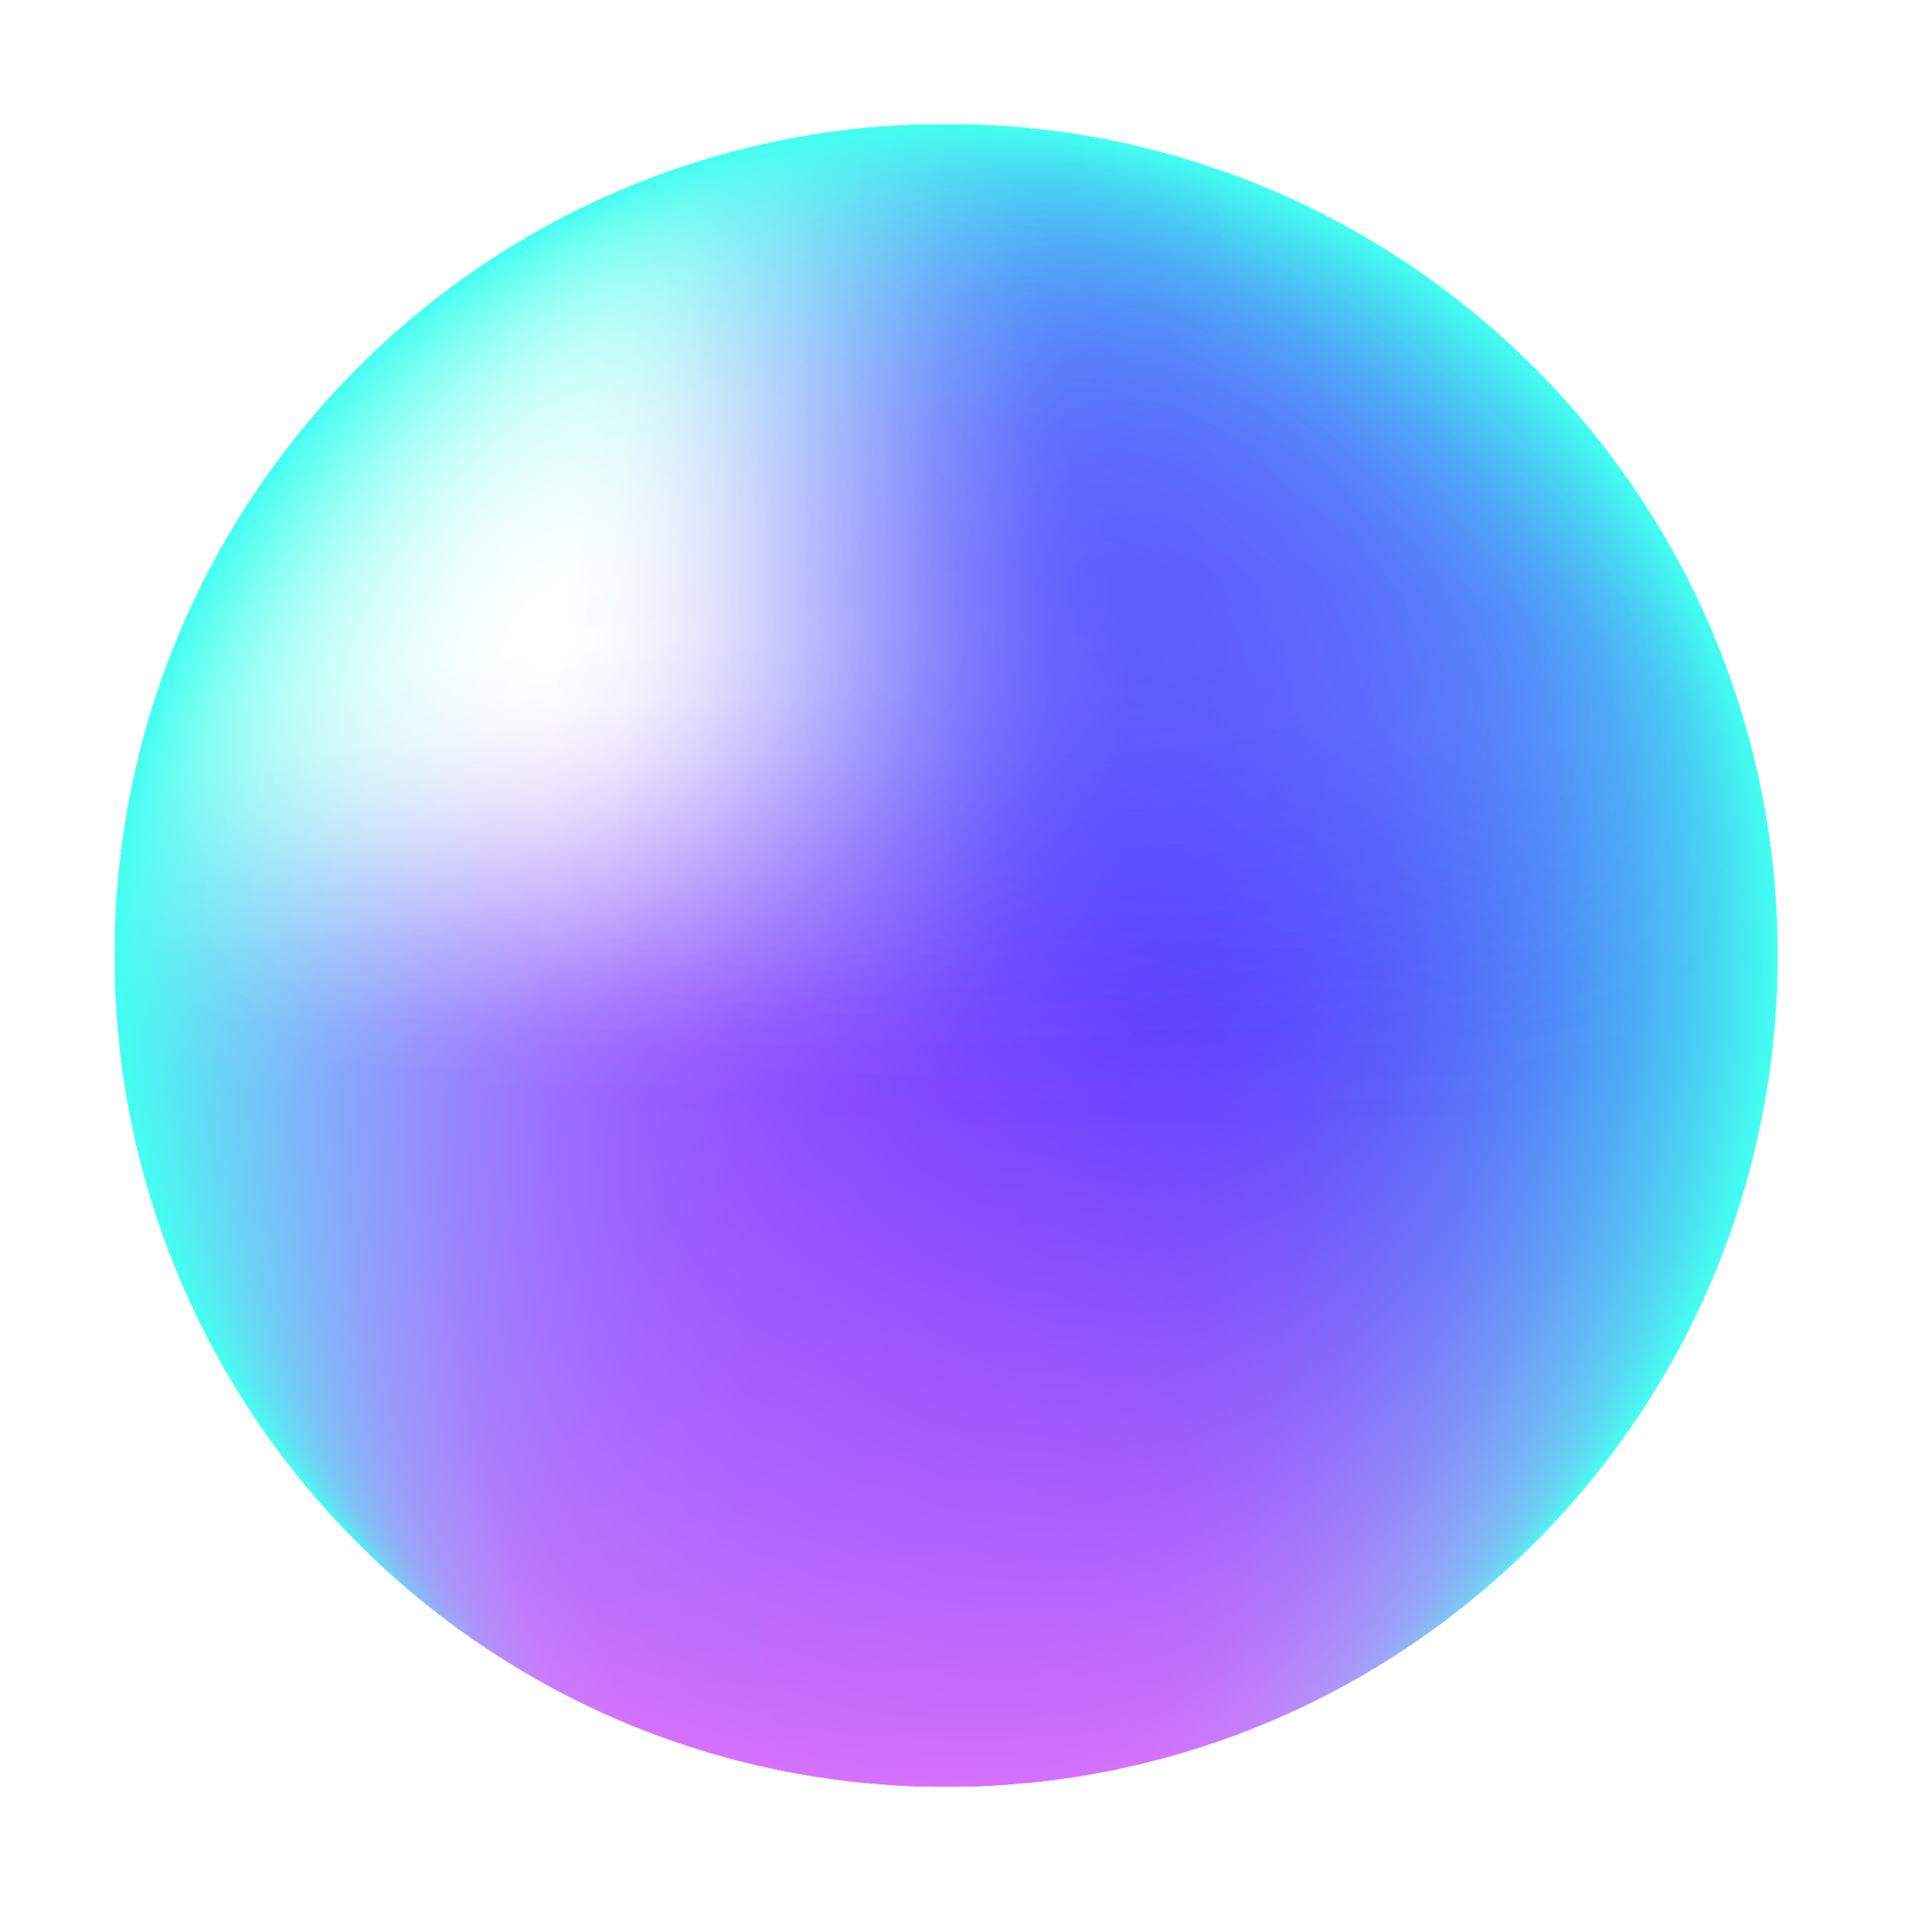
Brainstorming
explanation
01
02
Final results
Further improvements
03
04
How we reached the final idea?
How is the program working?
What could we add to improve it?
Which is the final result?

Slide 3
the idea
Hololens Christmas tree experience
Game to get rid of phobias
Grow your own plant
Bartender Training

Slide 4
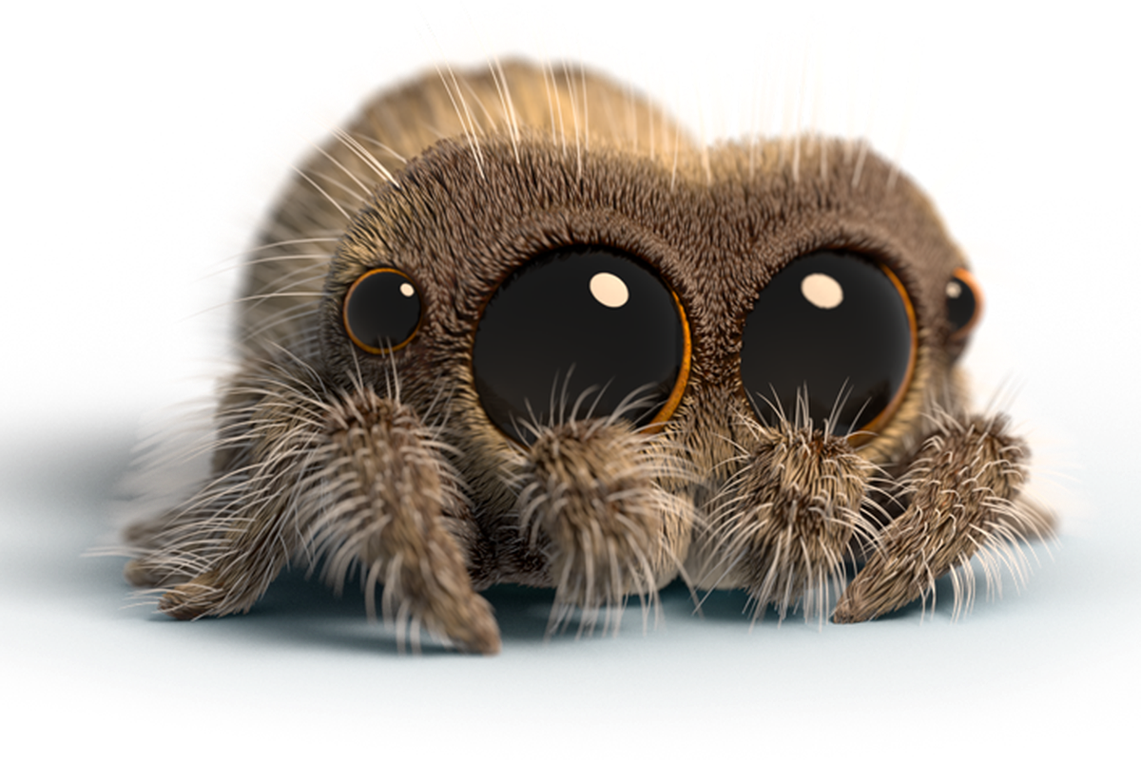
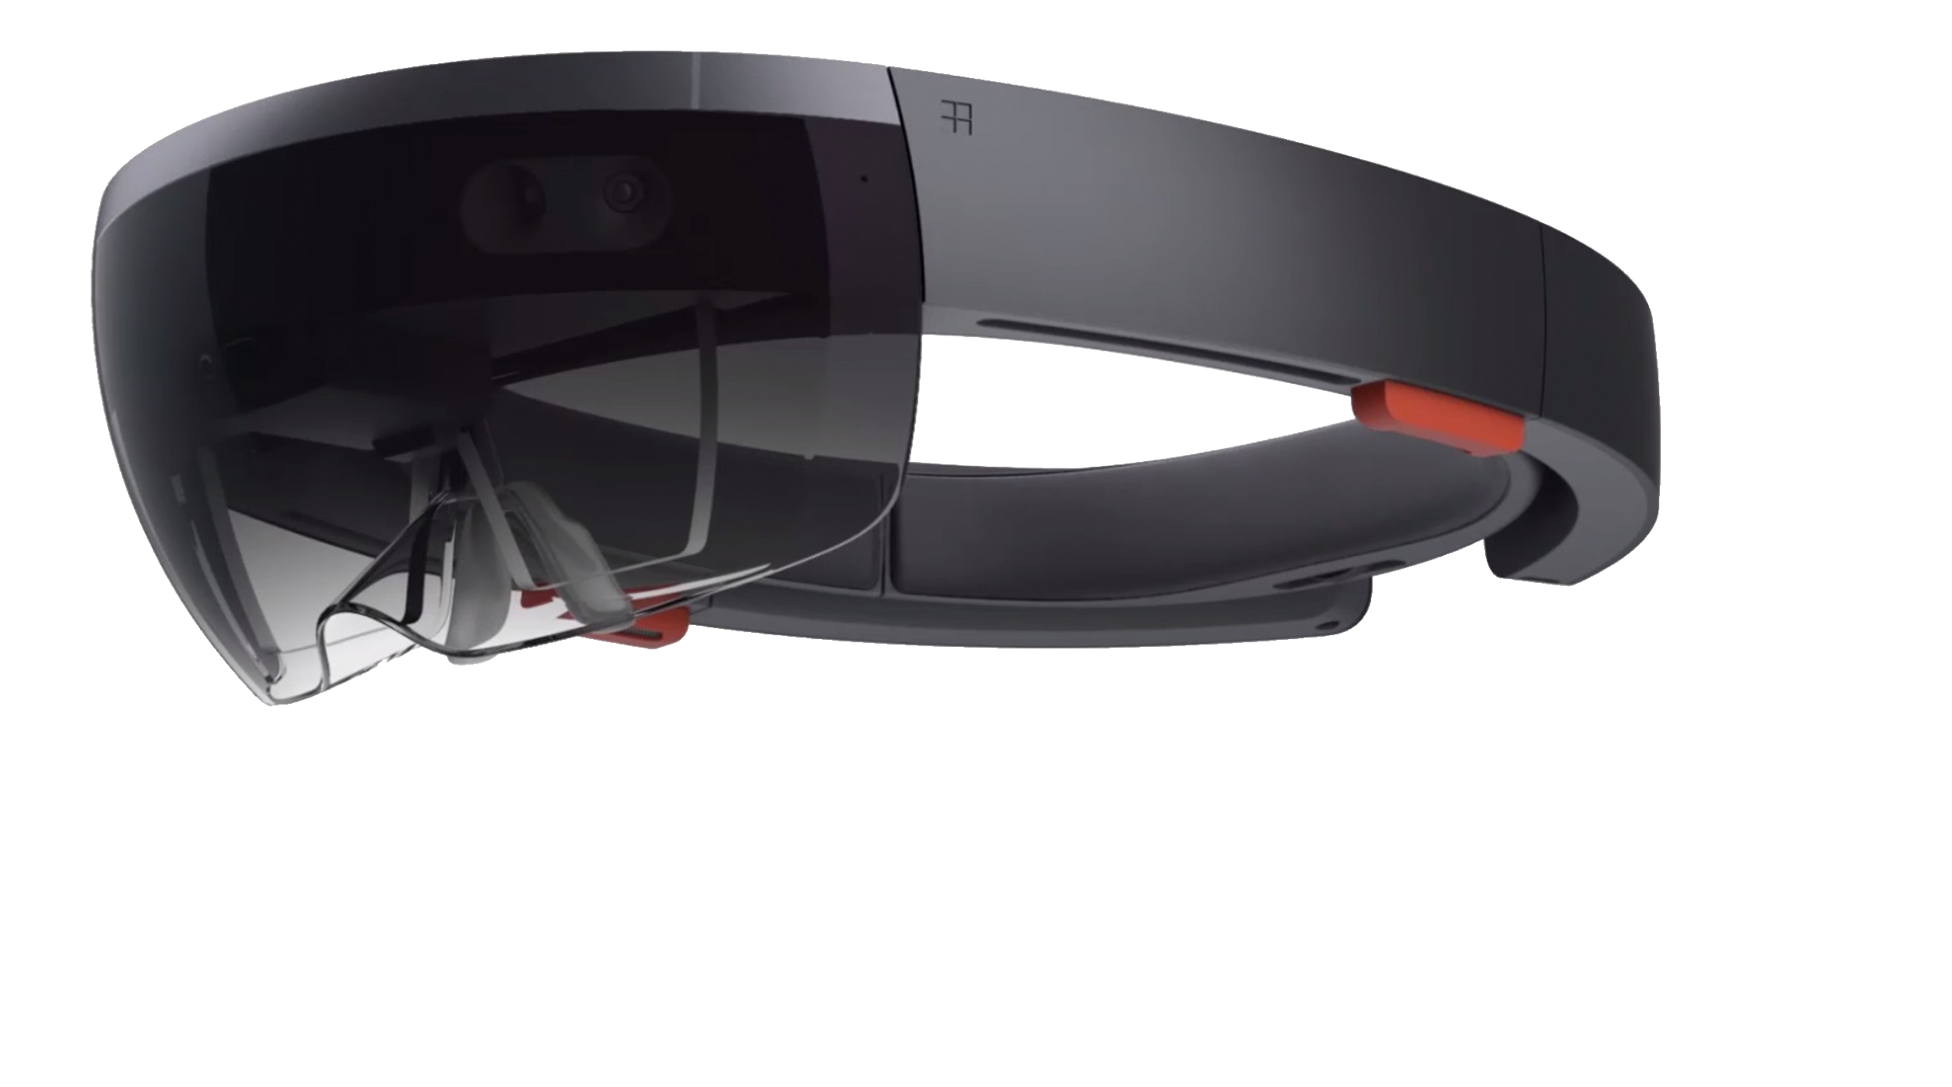
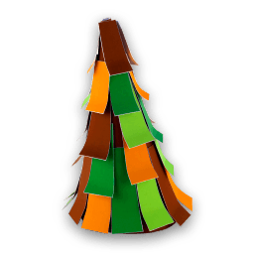
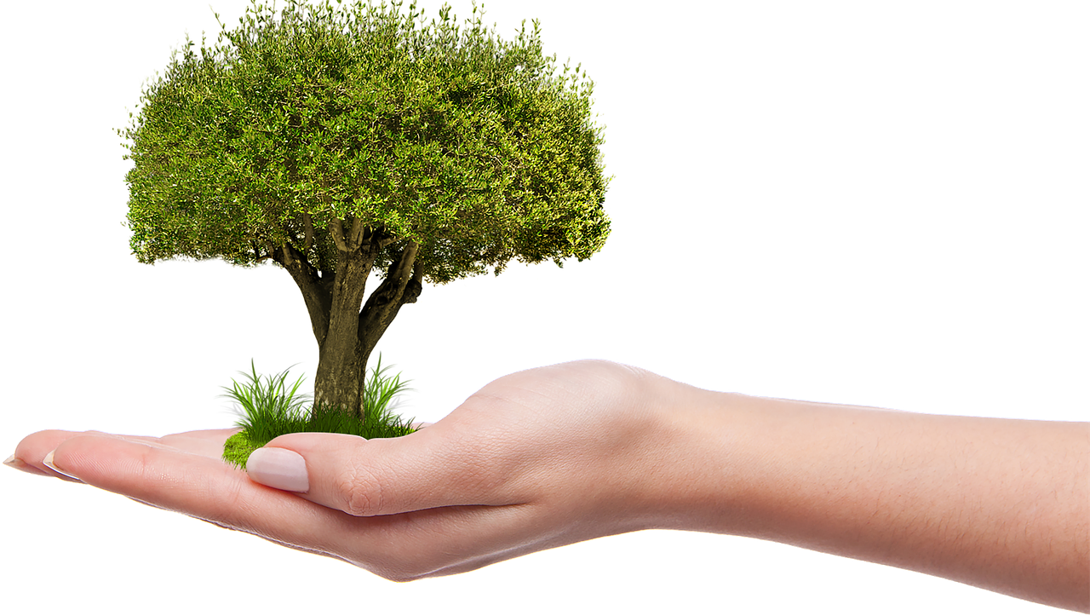

Slide 5
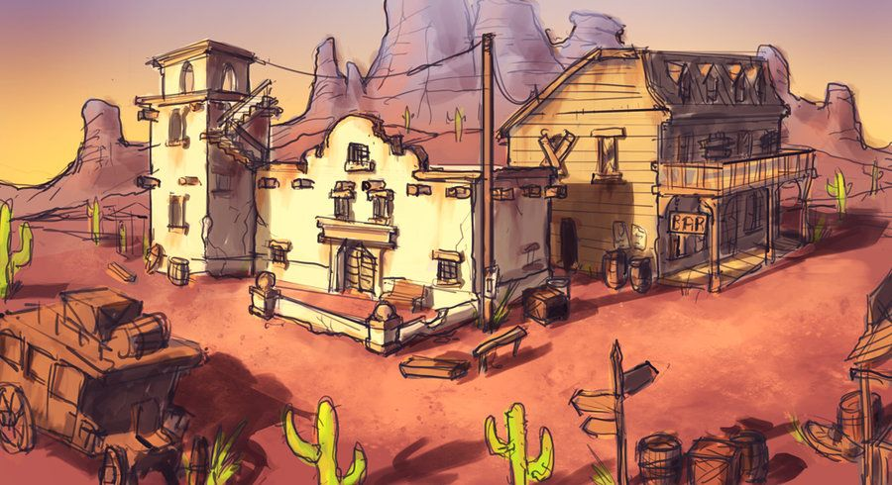

Slide 6

Logics
POURING
UI
gLASS fILLING
Vr interaction
TUtorial screeen

Slide 7
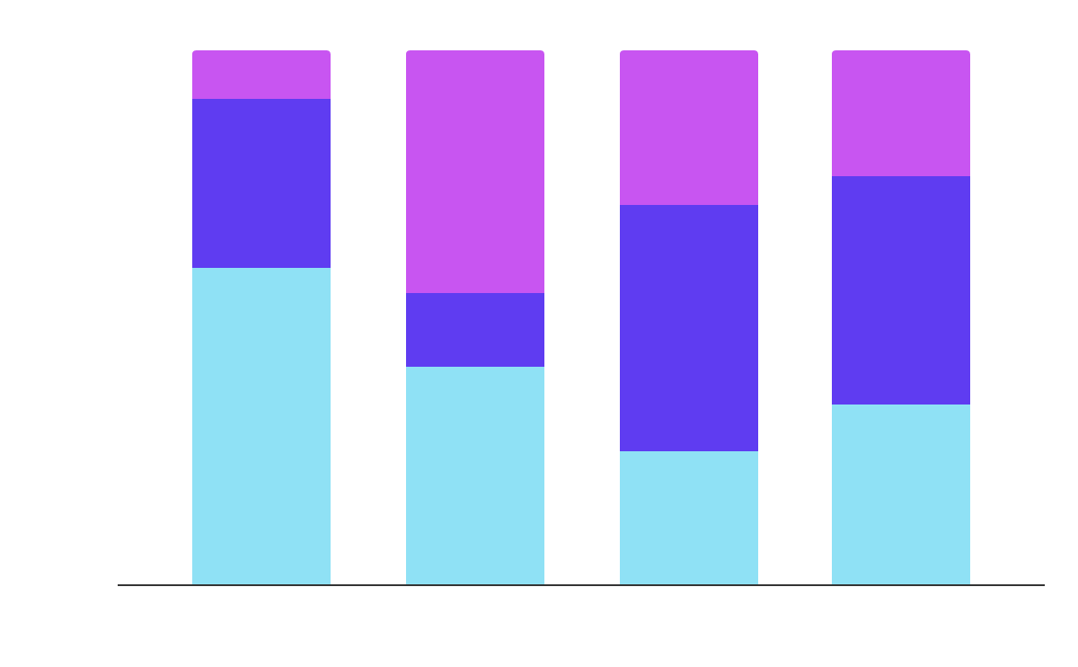
FURTHER IMPROVEMENTS
FLUIDS
Improve the fluids and add realistic animations
VAriety of cocktails
Add more drinks
Glass physics
Add the possibility of breaking the glasses
Survey to figure out the further improvements

Slide 8
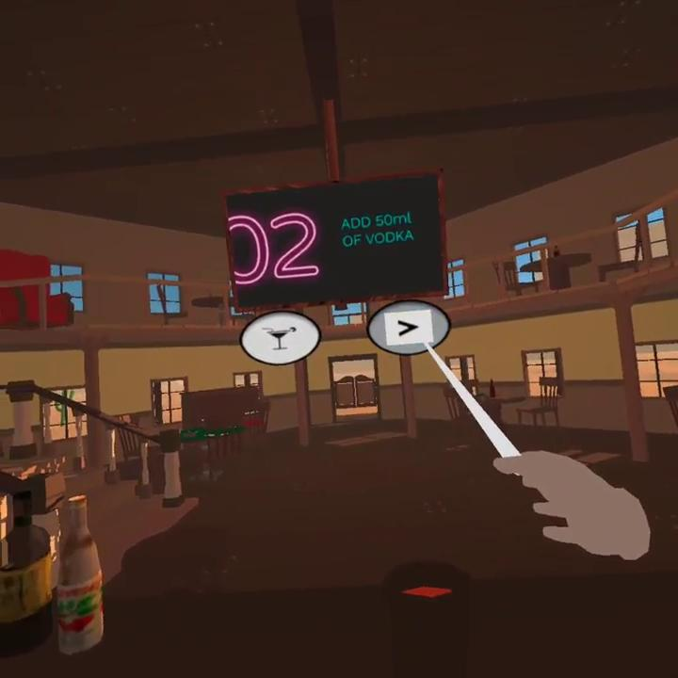

FINAL
OUTCOME

Slide 9
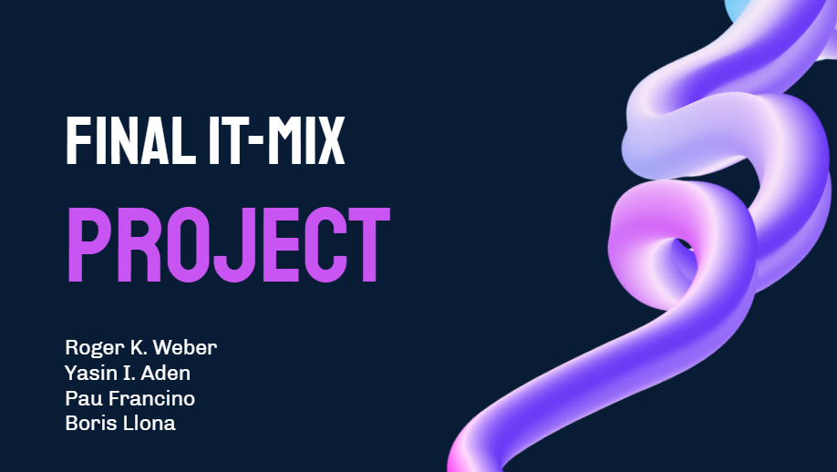
Any questions ?

Slide 10
Thanks for your attention
TAK FOR DIN OPMÆRKSOMHED

